Slide 1



Slide 2
Patent Bank
Our Digital Will is…

Slide 3
Table of contents
01
02
04
03
Our team
Our idea
Used Technologies
Stages of realizations

Slide 4
01
Our Team

Slide 5
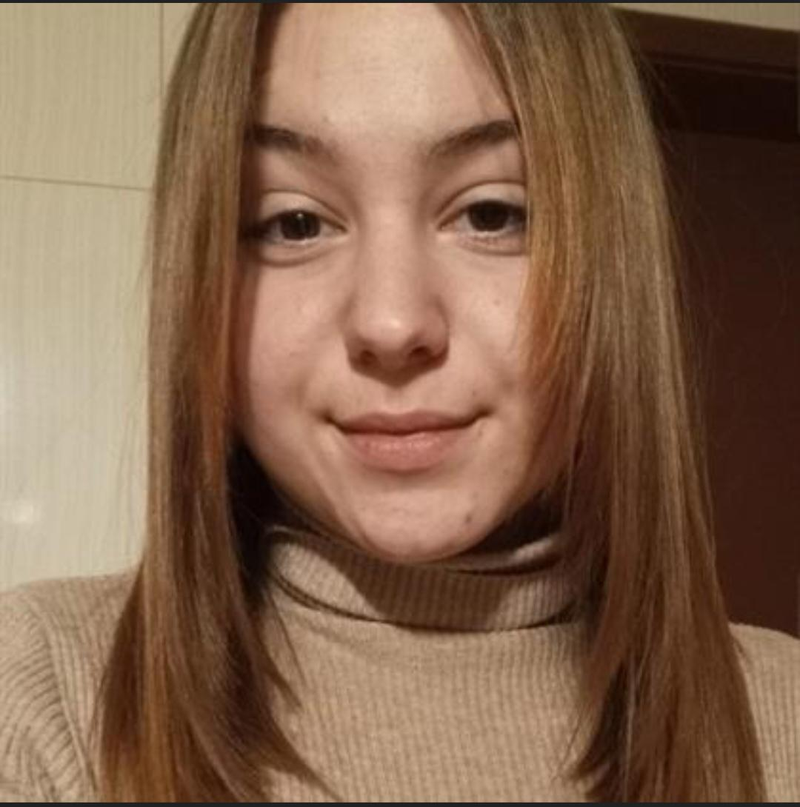
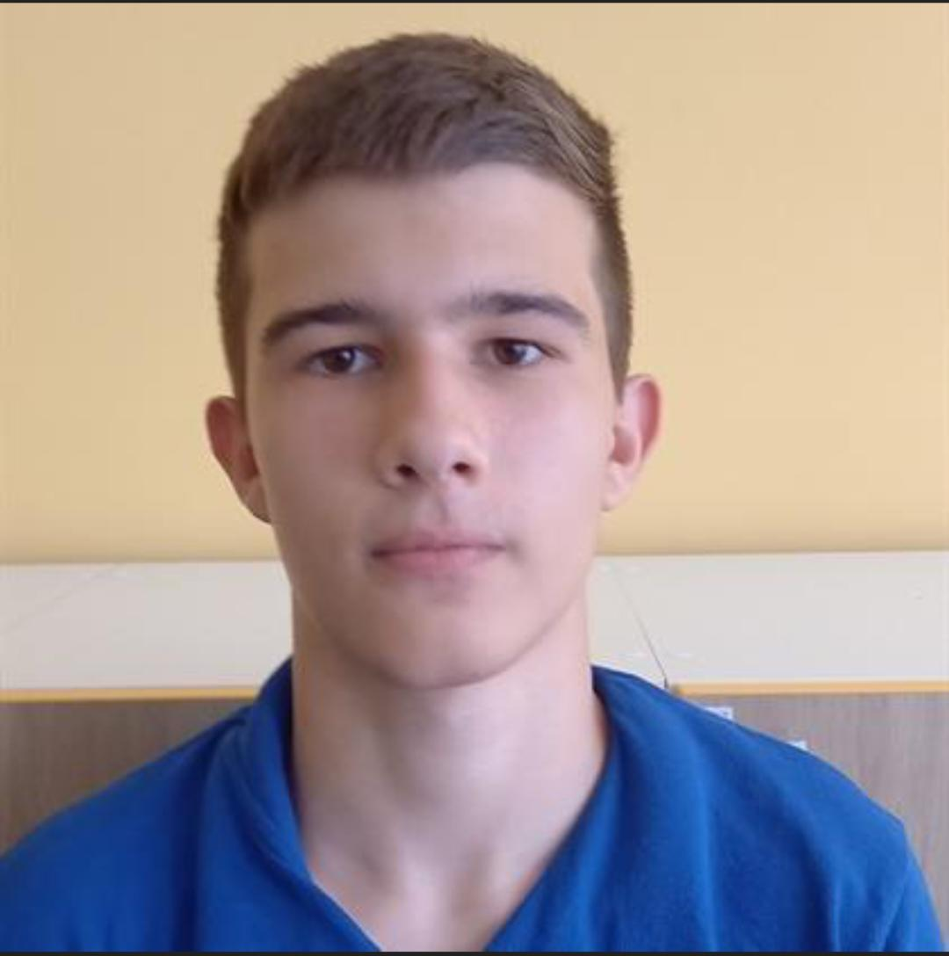
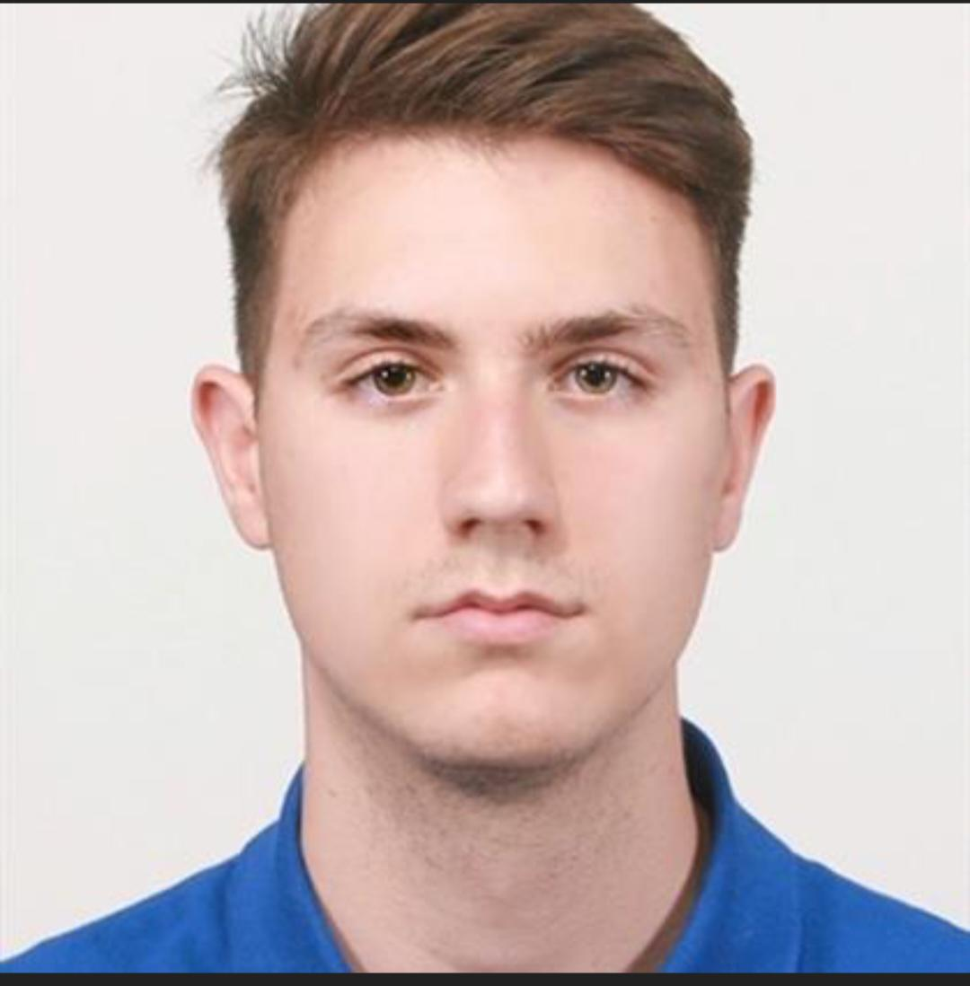
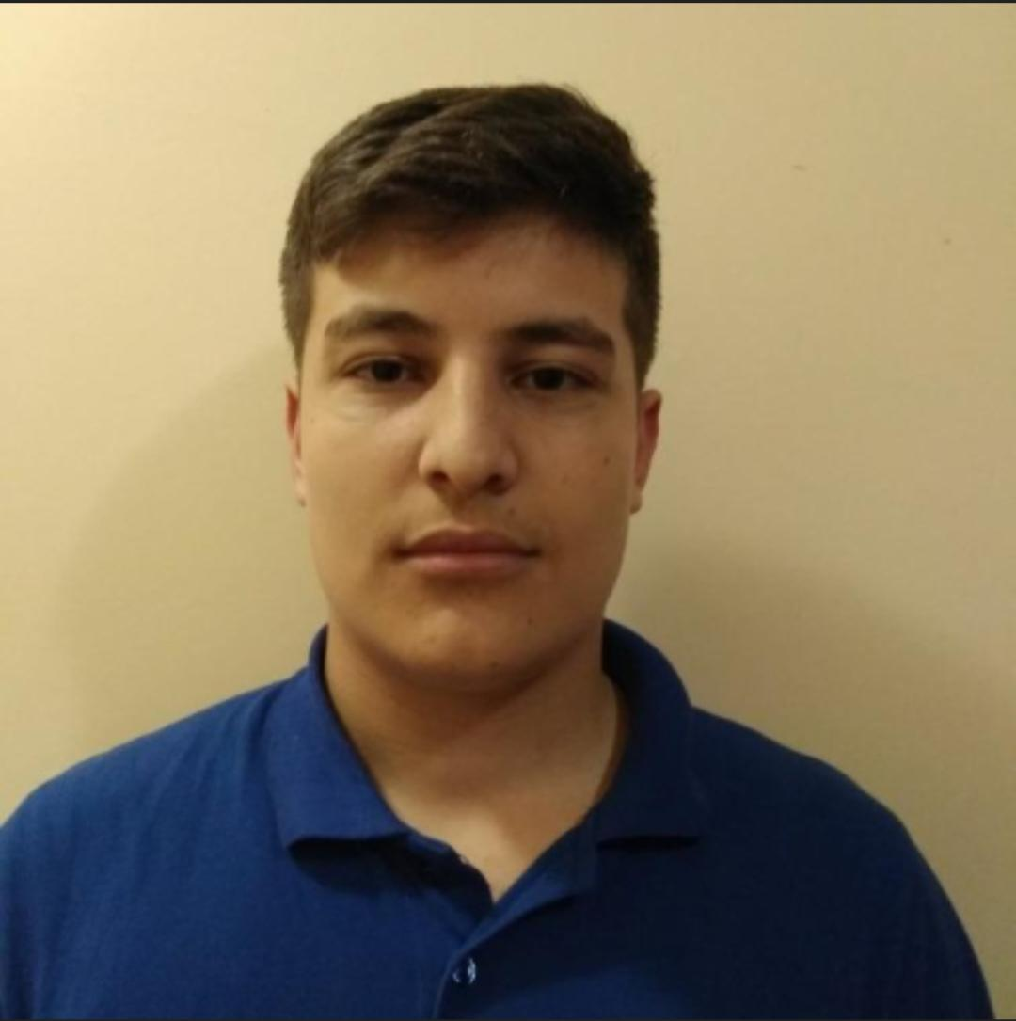
Jasmina Vulkova
Georgi
Filipov
Atanas Apostolov
QA and documentation
Backend developer
Scrum trainer
Ivailo Dandarinov
Frontend developer

Slide 6
02
Our Idea

Slide 7
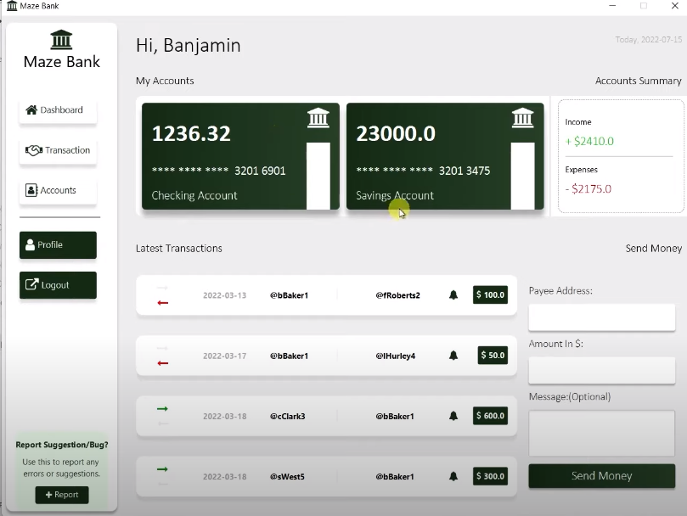
.
Our project is an application that helps manage people's finances (online bank ).

Slide 8
03
Stages of realization

Slide 9
01
02
03
04
Realization
Test
Present
Idea & organization

Slide 10
04
Used languages

Slide 11








Slide 12
Let’s jump into the app!

